Slide 1
High Performance Canny Edge Detection
Swapnil Aggarwal (A53271788)
Tushar Dobhal (A53243953)

Slide 2
Outline
What is Edge Detection? Why is it needed?
Why CUDA acceleration?
Canny Edge Detection - An Introduction
Gaussian Smoothening
Image gradient computation
Non-max suppression
Hysteresis thresholding
Adaptive Threshold Calculations (and why?)
Results - CPU vs GPU
Future Work

Slide 3
Motivation - Edge Detection
Provides a means of extracting edges or points of changing pixel intensity.
One of the key image processing techniques.
Finds use in pre-processing steps of various image processing applications such as feature detection, object detection, image segmentation, etc.
Even useful in deep CNNs where edge detection is used for extracting edge related features in lower layers.

Slide 4
CUDA Acceleration in Edge Detection
CUDA provides a means to effortlessly perform parallel image transformation.
Each thread can be programmed to work parallely on a pixel point.
Transformations such as filtering, convolutions, thresholding, etc usually follow an underlying pattern in pixels, and so each pixel’s transformation can thus be mapped, programmed and addressed easily using its thread numbers.
Locality of thread variables further helps in storing and quicky utilising pixel features such as intensity, gradient, etc.

Slide 5
Canny Edge Detector
One of the most famous edge detection algorithms, proposed by John Canny in 1986.
Stands out as one of the simplest and most effective algorithms before DNNs took over advanced image edge detection in recent years.
Consists of the following basic image transformation steps:
Grayscale Conversion: Convert RGB Image - 8-bit Grayscale
Gaussian Smoothening: Gaussian Filtering to reduce noise and smoothen its texture.
Gradient Computation: Calculate the intensity gradients along X and Y direction in the image.
Non-Maximum Suppression: Find the sharpest edge values and remove redundant gradient values obtained in the previous step.
Hysteresis Thresholding: Remove weak edges further from the strong edges obtained after non-maximum suppression.

Slide 6

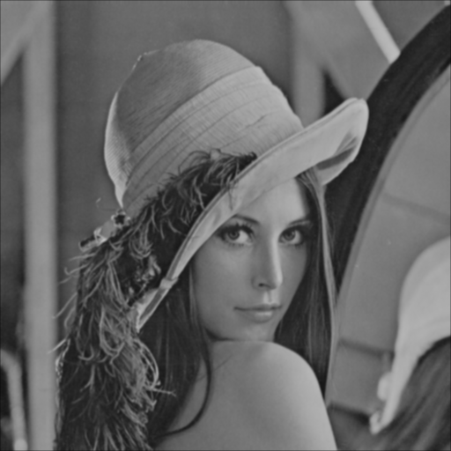
Gaussian Smoothening
Perform convolutional filtering using the Gaussian Kernel of variable size (size can be 3, 5, 7…).
Results in a smooth and blurred image.
Removes unnecessary features of noise.
Helps in correct extraction of gradients in the following processes.
Shared Memory is used for Convolution implementation
G_{xy}
Notes:
Better than a simple Box filter, as it messes with the frequencies. We used shared memory for convolution. First step stores the Image data into shared memory, then the values are read by convolving with the kernel

Slide 7
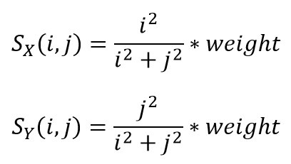
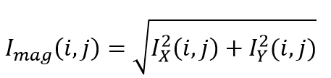
Image Gradient Computation
Calculating the gradient helps to find out the points of changing intensity, and hence the edges.
The gradient is calculated in both X and Y directions using a variable size Sobel kernel as follows -
Convolutional filtering helps us to obtain both the values.
The final magnitude of gradient is calculated as follows -
Notes:
Gradient in the original algorithm is calculated by subtracting the neighboring pixels. But that doesnt give good gradient computation. We used sobel filter and convolved with the image using shared memory

Slide 8
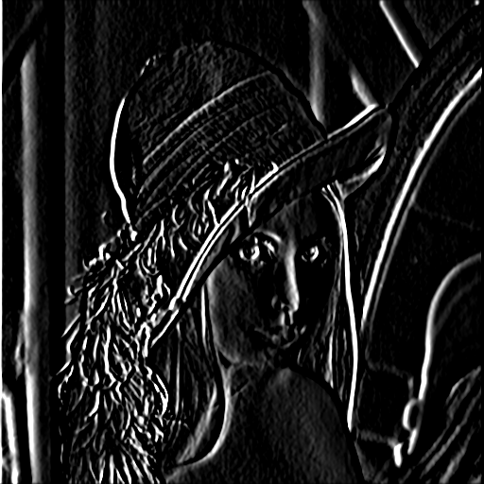
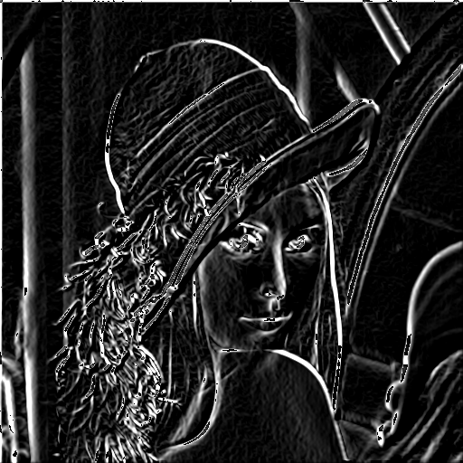
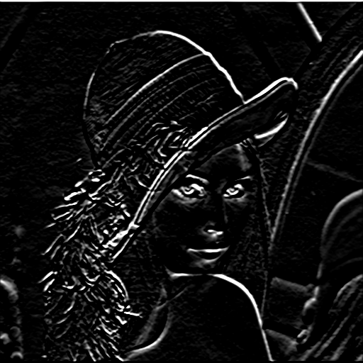
I_{x}
I_{g}
I_{y}
I_{mag}

Slide 9
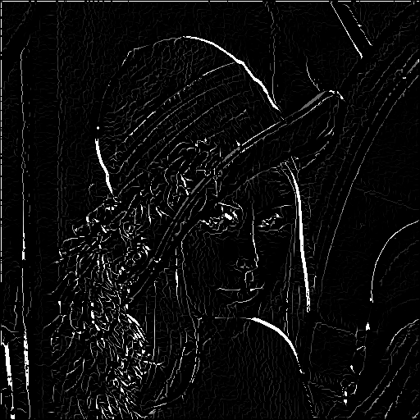
Non-Maximum Suppression
Calculate the sharpest edge by checking for the angle of the gradient magnitude, which is calculated as follows:
Helps us to remove those pixel points that do not actually lie along any specific edge corresponding to a particular direction (e.g. North-East, South-West, etc.
Provides a true picture of the edges in an image.
2D grid and block structure gave best performance
I_{mag}
NMS
I_{nms}
Notes:
2D grid and block size gave best performance – (32,2)

Slide 10
Hysteresis Thresholding
Used to filter out strong edge values, and weak edge values near the strong edges.
Ideally we would only like to classify strong edges with edge values greater than a certain strong threshold.
Moreover, we would also like to include those points near those strong edges which have pixel values greater than a weak threshold near those strong edges, using a certain weak threshold value.
Originally, weak and strong threshold values for edge detection used to be fixed.
Can be made adaptive according to the image pixel values.

Slide 11
Adaptive Thresholding - Motivation
Every image has its own pixel intensity variations across the image.
Singular strong and weak edge threshold values will not necessarily work better for all types of images.
Intel suggested using a scaled version of the mean of the image as low and high thresholds
Thresh_{low} = 0.66 * I_{mean} and Thresh_{high} = 1.33 * I_{mean}
Proved to generalize well on our testing as well
Shared Memory with Unrolling is used to compute the sum of image pixels
Notes:
Original algorithm used fixed thresholds. This was the main disadvantage of the method as it could not be generalized for all images. We used shared memory with unroll for computation of the sum of image pixels. It performed better than just Shared Memory, or using shuffle operation

Slide 12
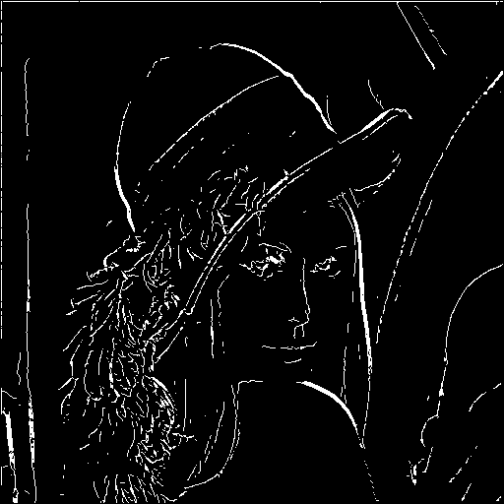
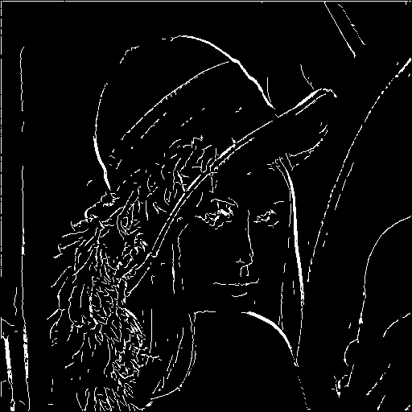
I_{nms}
I_{thresh_high}
I_{thresh_low}

Slide 13
Results CPU vs GPU (Lena - 512x512)
Canny Edge Step | Host Time H_{t} (ms) | Device Time D_{t} (ms)
Gaussian Smoothening | 8.40 | 0.086
Image Gradient (X) | 15.32 | 0.158
Image Gradient (Y) | 15.29 | 0.156
Image Gradient (Magnitude) | 6.98 | 0.02
Non-Maximum Suppression | 2.98 | 0.037
Threshold Computation | 0.51 | 0.127
High Hysteresis Thresholding | 0.52 | 0.015
Low Hysteresis Thresholding | 1.74 | 0.034
Total | 51.749 | 0.638
Notes:
We implemented the same algorithm on the host side as well for comparison. This is run under release mode

Slide 14
Results CPU vs GPU
Image Size | Host Time H_{t} (ms) | Device Time D_{t} (ms) | Speedup (= H_{t} / D_{t})
416x416 (173,056 px) | 35 | 0.465 | 75.27
512x512 (262,144 px) | 52 | 0.638 | 81.11
800x450 (360,000 px) | 69 | 0.85 | 81.17
1392x876 (1,219,392 px) | 250 | 2.532 | 98.74
3917x4593 (17,990,781 px) | 3581 | 33.09 | 108.22
Notes:
This is run under release mode

Slide 15
Results with Various Images
Using CUDA acceleration, algorithm performs exceedingly well for all types of images.
Results computed with various different images of different sizes: 250x250 to 4K images.
The system scales appropriately well for all, showcasing equivalent speedup of ~ 75x - 110x for different images.
In the following examples, no hyper-parameters of the Edge Detection algorithm were changed.

Slide 16
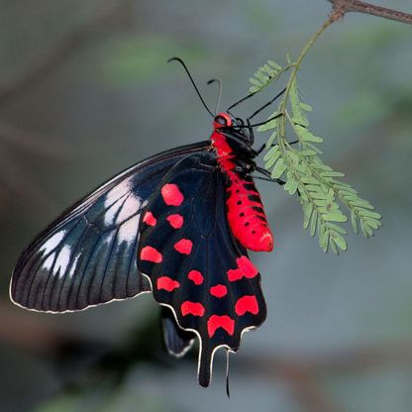
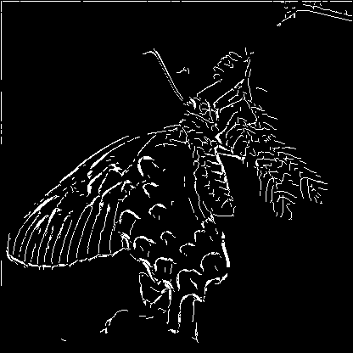
Small-sized Image
Image size - 416x416 = 173,056 pixels

Slide 17
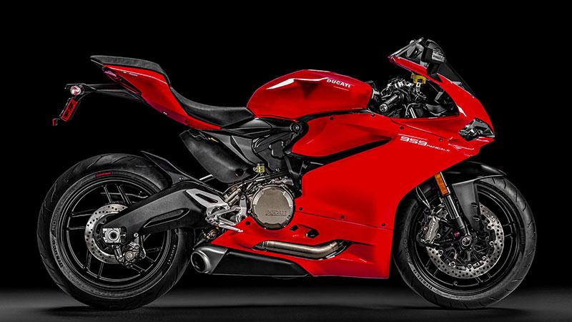
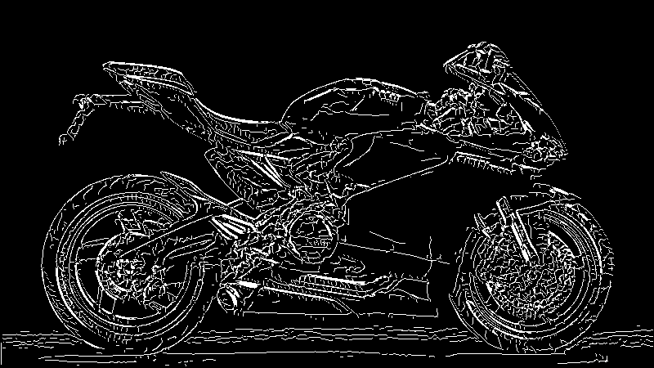
Medium-sized Image
Image size - 800x450 = 360,000 pixels

Slide 18
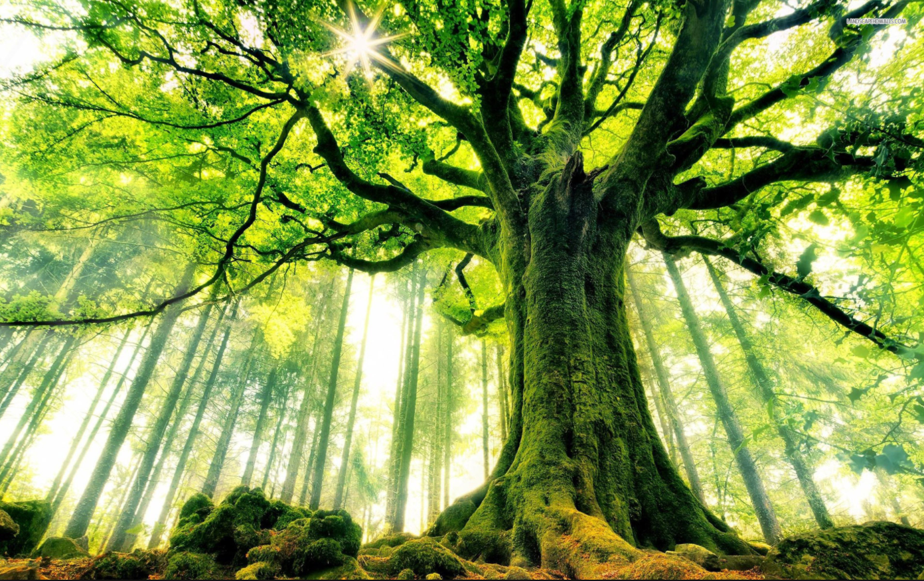
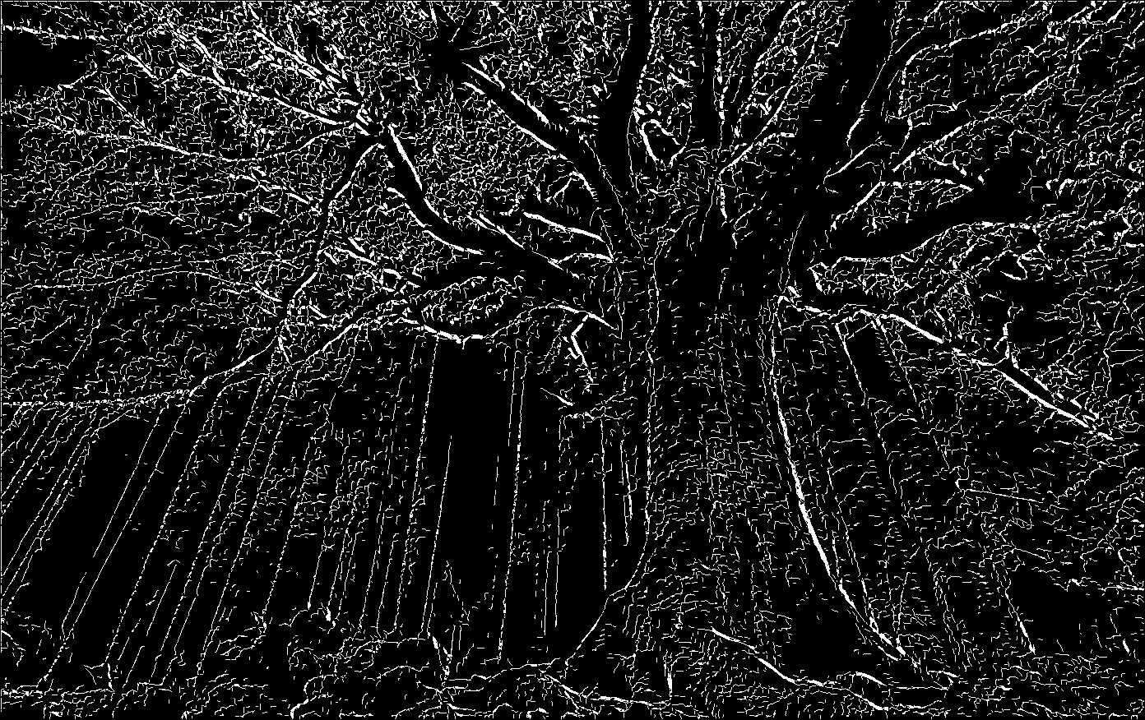
Large-sized Image
Image size - 1,392x876 = 1,219,392 pixels

Slide 19
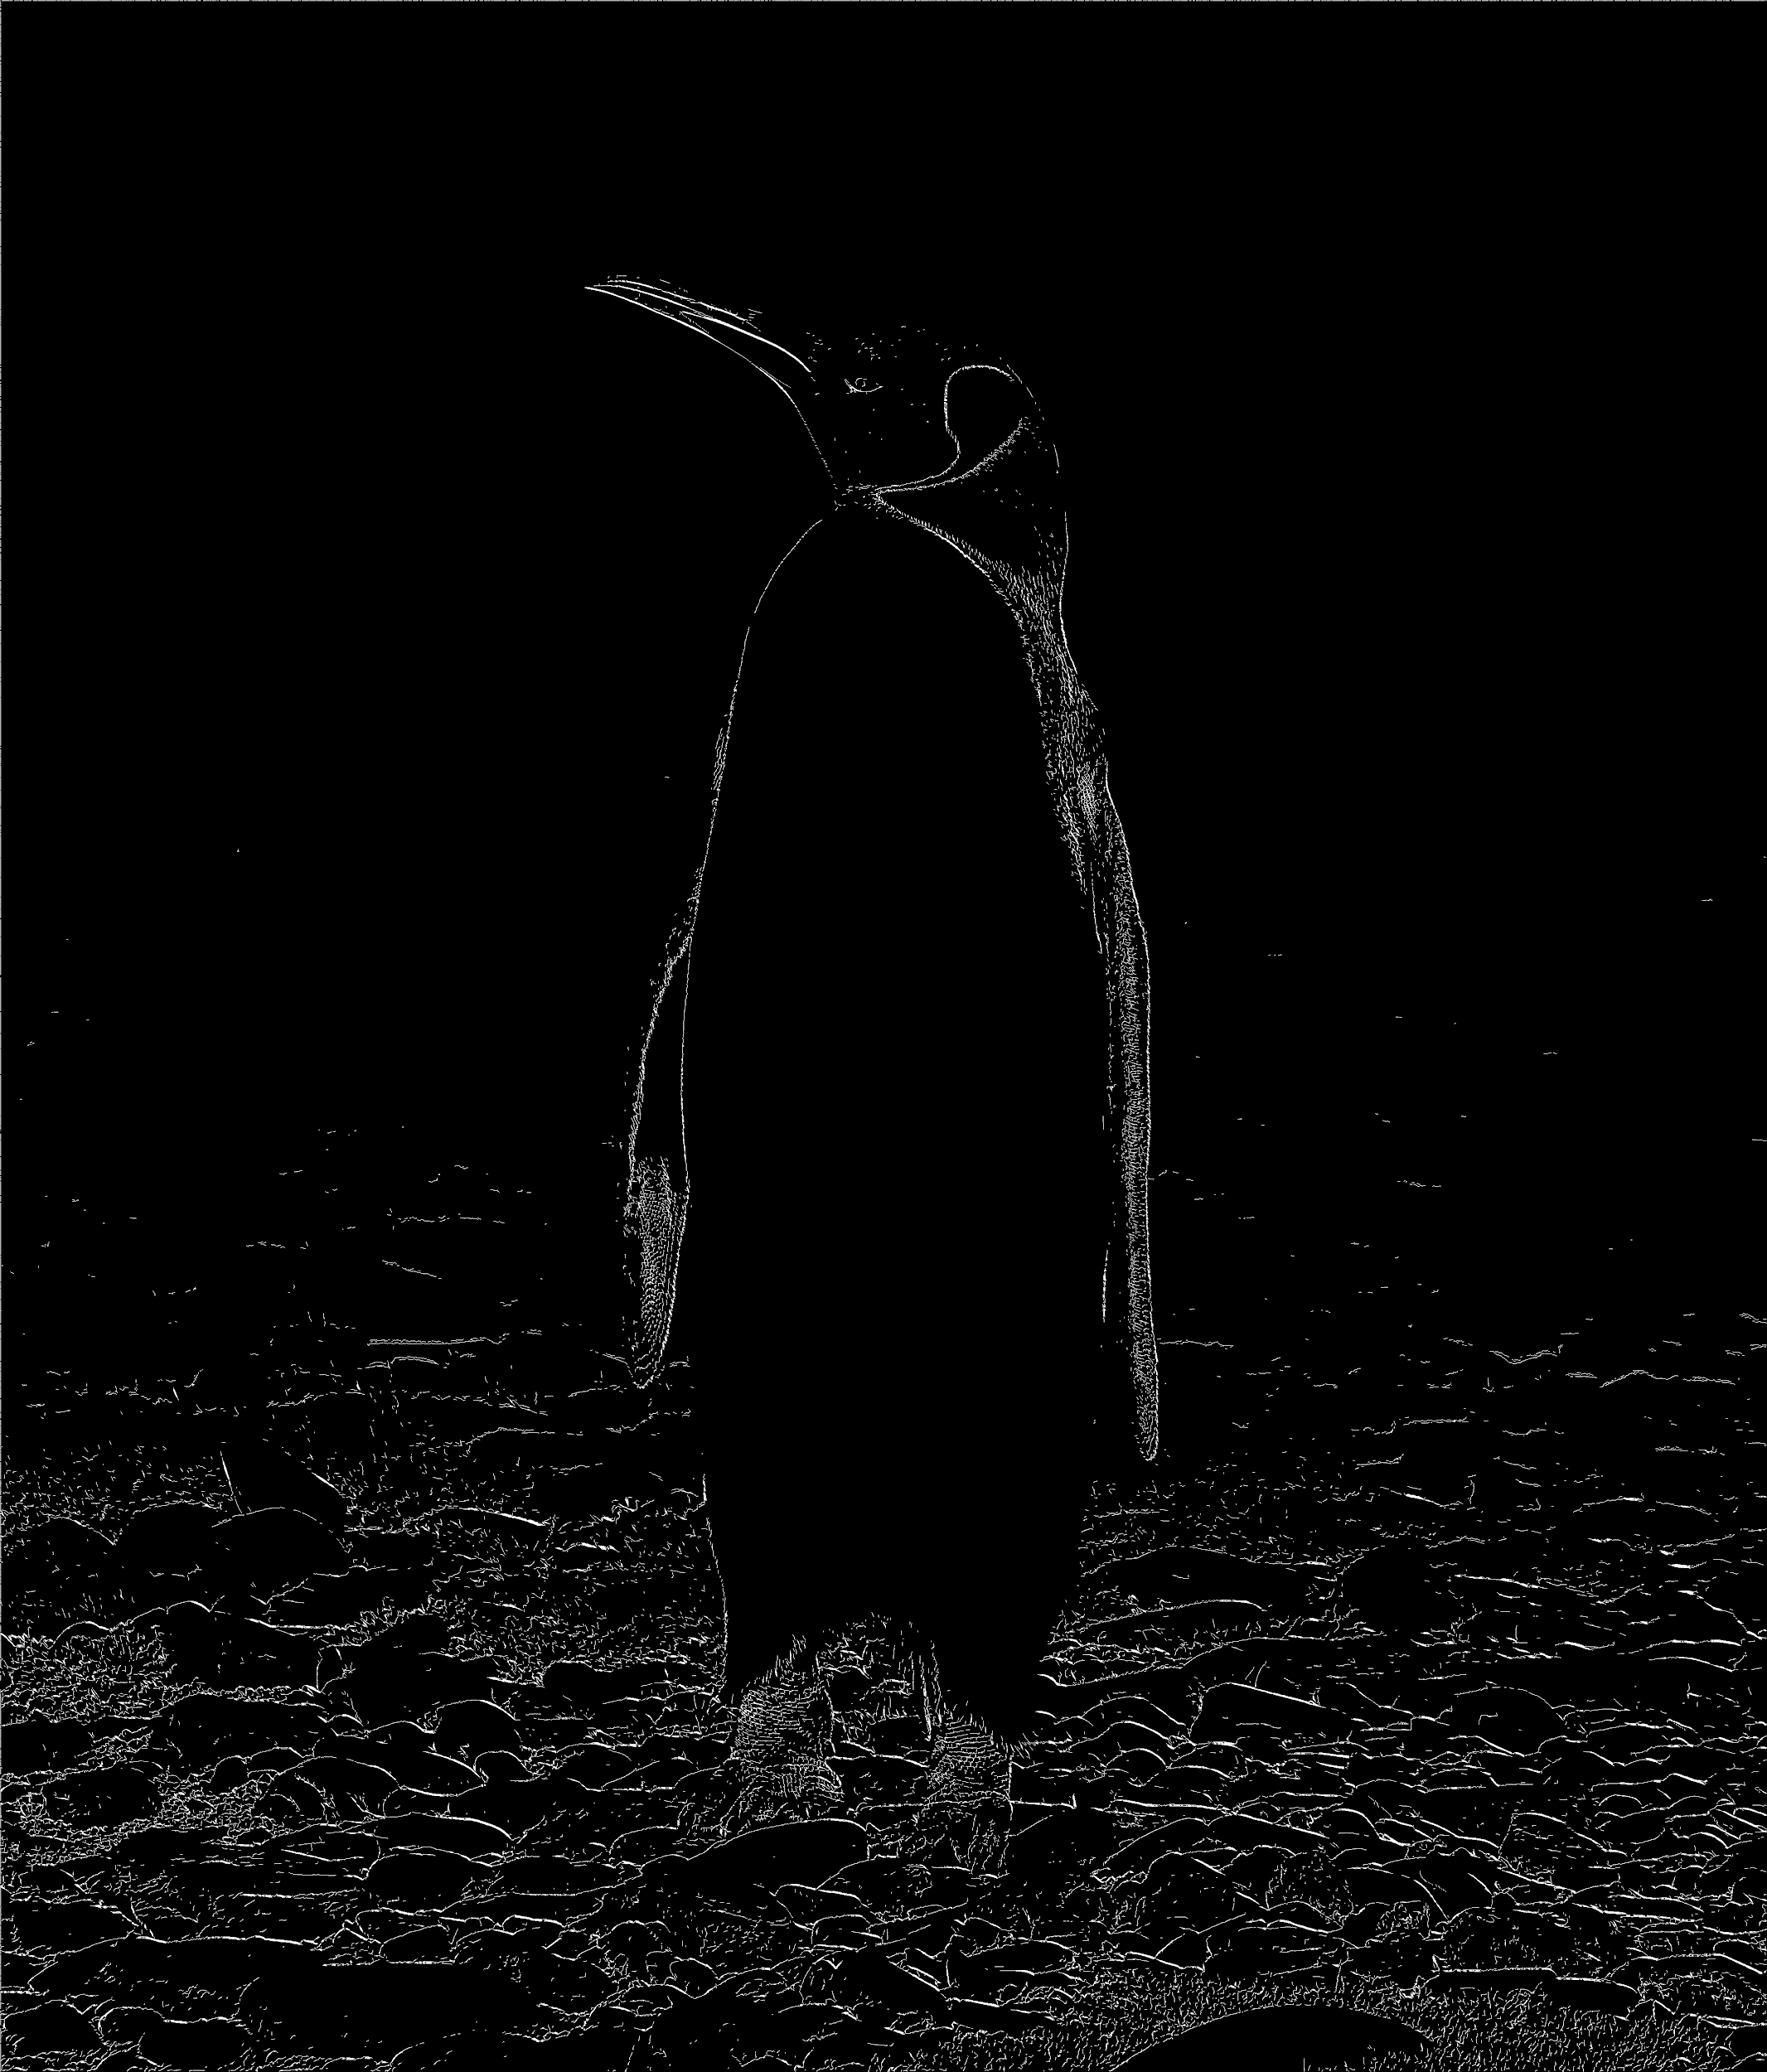
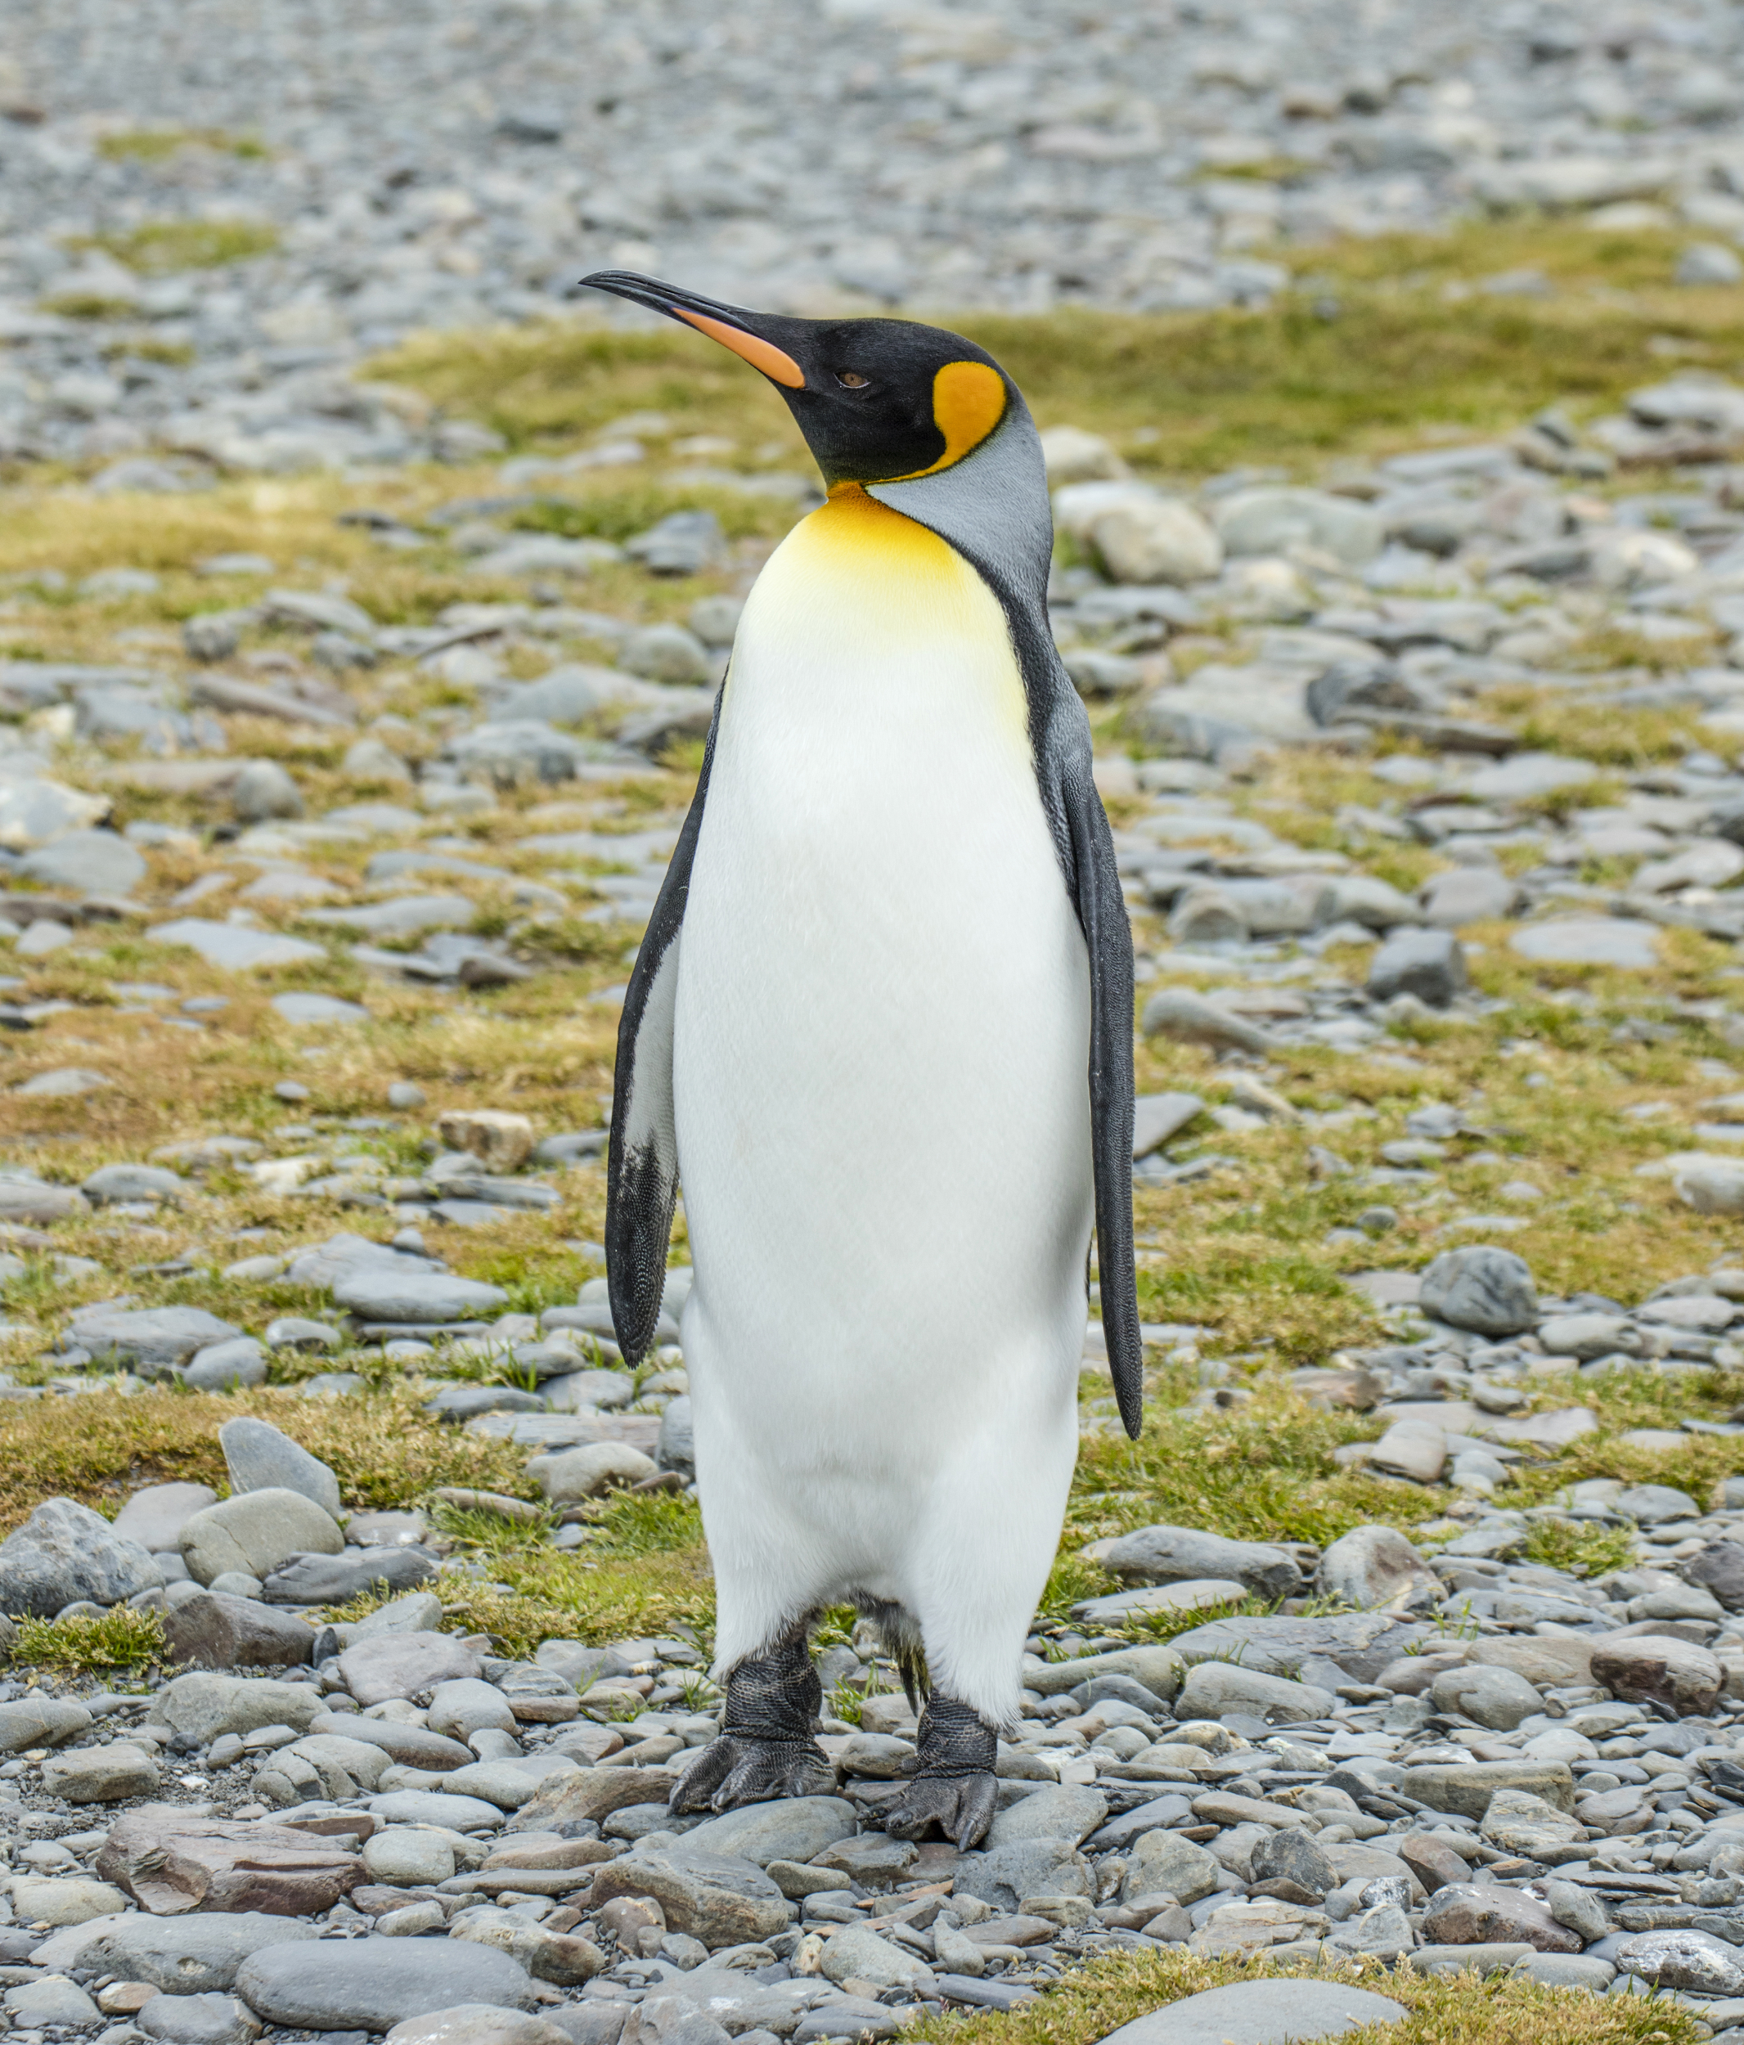
Very Large-sized Image
Image size-
3917x4593= 17,990,781 px

Slide 20
Future Work
Could apply more varieties of adaptive thresholding for better edge detection.
learnable thresholds exist which go hand in hand with ML based methods
Using texture memory to speedup convolution calculations.
But might require to consider only fixed size kernels
Incorporation of DNN techniques for more dynamic edge detection algorithms
Deep learning techniques have shown to perform better nowadays
Notes:
Need to add more

